Slide 1
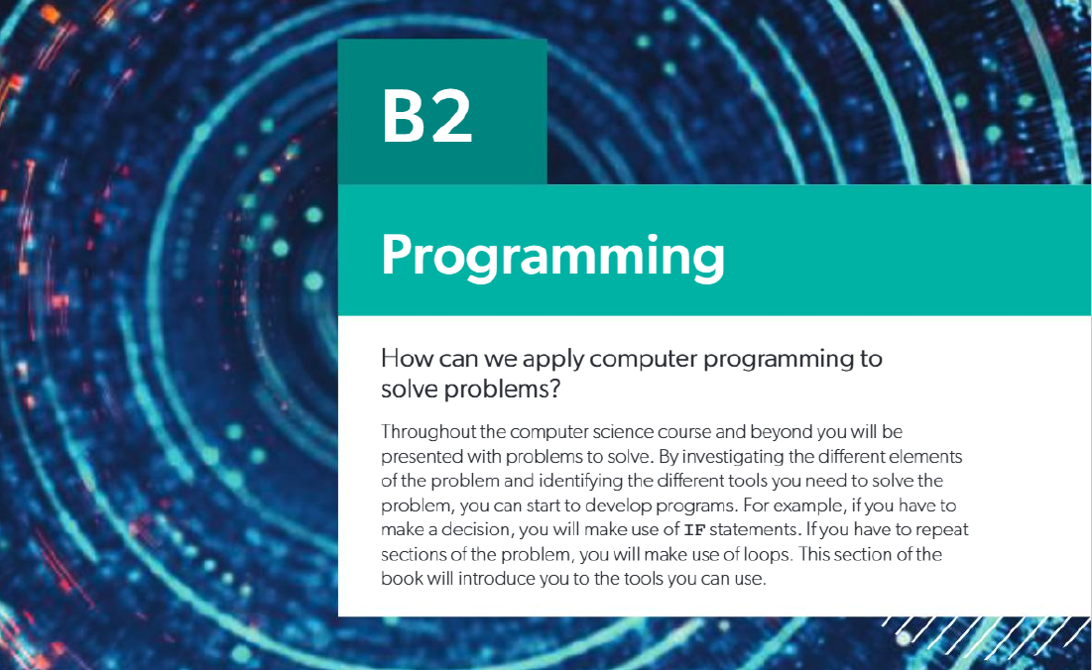

Slide 2
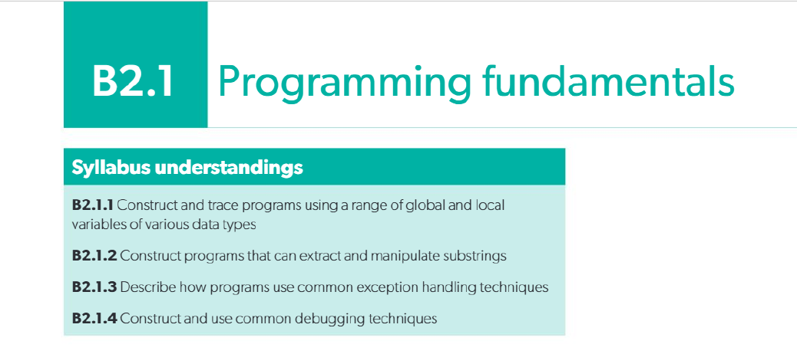

Slide 3
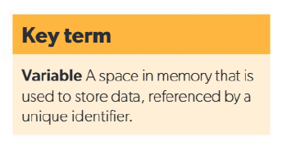
B2.1.1 Construct and trace programs using a
range of global and local variables of various
data types
A variable is a space in memory used to store data, referenced by a unique _identifier.

Slide 4
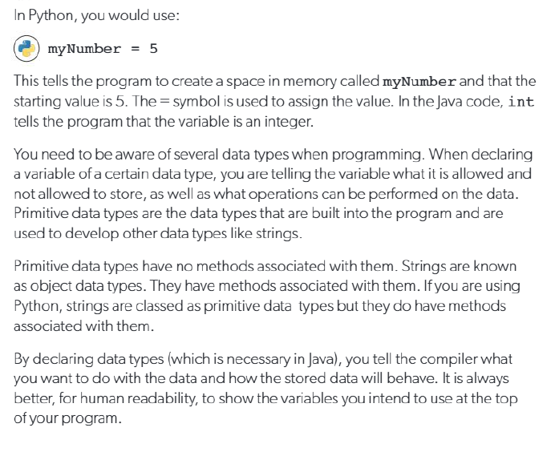

Slide 5
Data type | Description | Assignment in Python | Example
Boolean | A variable whose value can be true or false | x: bool = False | True, False
Char | A single character or single ASCII value | Python does not have a char data type. Use strings instead.c: str = 'a' | J, q, 4, %, !
Decimal | A number containing a decimal point | f: float = 7.99 | 1.9283, 2345.12, -594.39393
Integer | A whole number | i: int = 0 | 29399, 4, -2992
String | An alphanumeric collection of characters | s: str = "hello" | "Hello", "45 Main Street", "P@ssw0rd!"

Slide 6
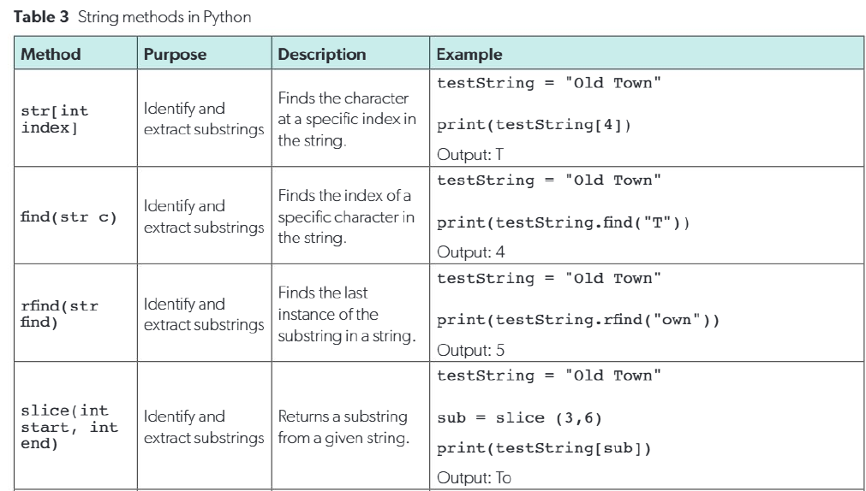

Slide 7
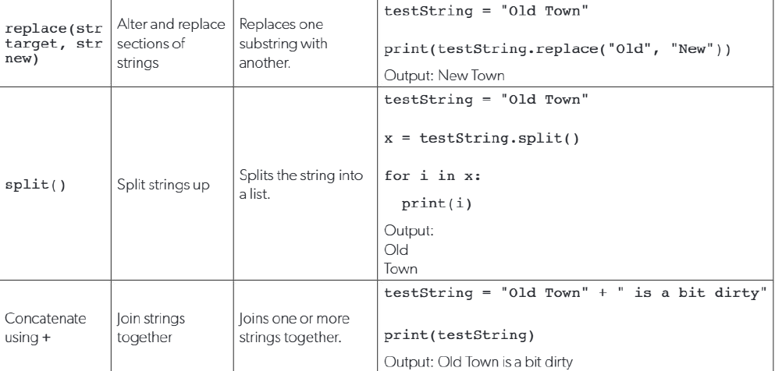

Slide 8
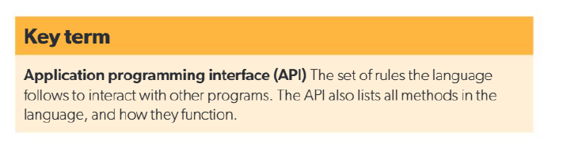
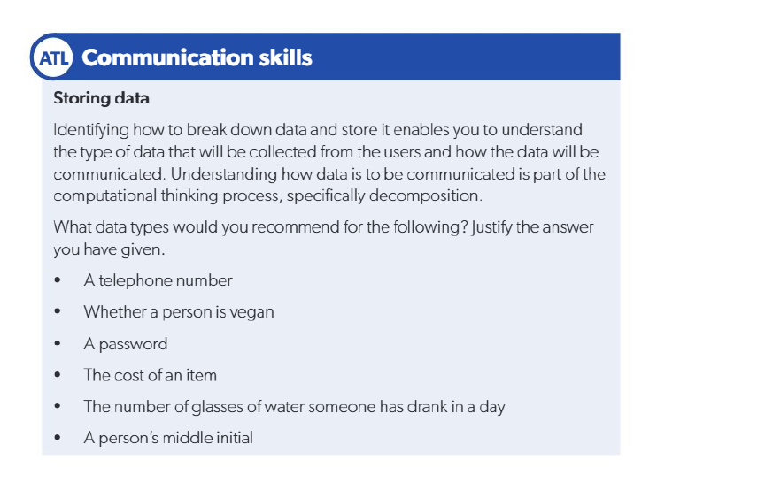
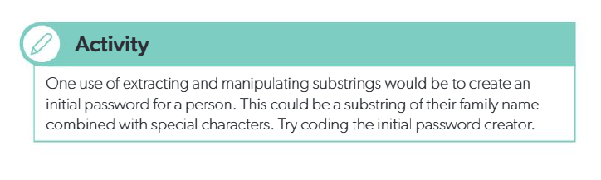

Slide 9
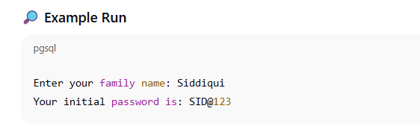
# Initial Password Creator
# Ask user for their family name
family_name = input("Enter your family name: ")
# Extract a substring (first 3 letters of family name, uppercase)
substring = family_name[:3].upper()
# Add some numbers and special characters
password = substring + "@" + "123"
print("Your initial password is:", password)

